Slide 1
ENSE 374, Milestone 1
Boiling Frogs
Kegan Lavoy, Mohamed Aly, Annoor Rahman, Mandeep Singh, Mansi Patel, Brandon Clarke
^{September 27th, 2018}

Slide 2
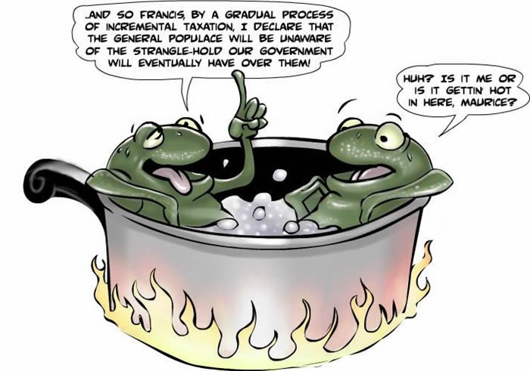
Team introductions
Kegan Lavoy
Mohamed Aly
Annoor Rahman
Mandeep Singh
Mansi Patel,
Brandon Clarke

Slide 3
Problem definition
Original Problem Definition
  Who: Engineering Dept, Students, Admin staff, HR, IT Department
  What: Designing Intranet Website for Faculty of Engineering.
  Where: Engineering web page, internal server, network drive and content management system.
Revised Problem Definition
  Naming is not standardized , there isn’t role based access privileges
  There are a lot of duplications
  How to make it accessible and easy for navigation and finding documents
  Need to keep up to date documents

Slide 4

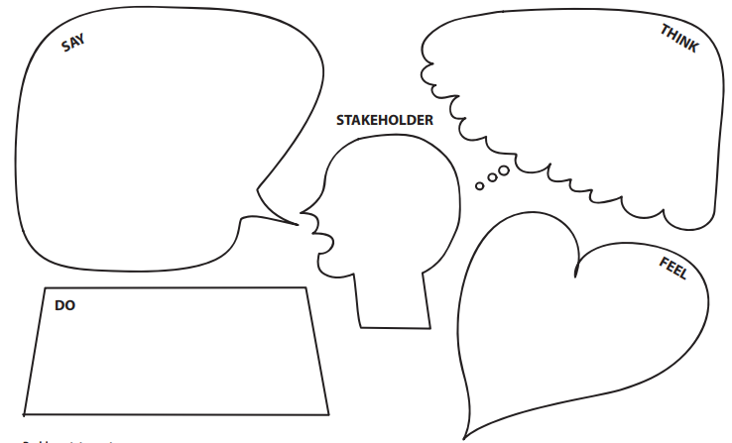
Empathy map: Administration
Keywords:
-Organization
-Security
-Privacy
-Easy Access
-Efficiency
-Concerned about privacy
-Difficult to find up to date documents
-No clear organization strategy
-Issues giving access of specific files to
specific users
-Duplicate files being created
-Work is inefficient
-Ease of use
-Annoyed
-Lost
-Exhausted

Slide 5
Empathy map: Faculty Members
Keywords:
-Understanding
-Centralized
-Share
-Organization
-Understanding
-Ease of use
-Efficiency
-Difficulty finding forms
-More info regarding committees and
members involved
-Training documentation
-Easy Way to upload documents
and share teaching ideas
with colleagues.
-Out of the loop
-Frustrated

Slide 6
Empathy map: IT
-Ease of use
-Create new system
focused on student
learning
Keywords:
-Student focused
-Easy use
-Maintain/Sustain
-Using Cascade Server
-Usable by non-technical staff users
-Student focused content
-Sustainable
-Maintainable
-Perhaps overwhelmed if requests are too much

Slide 7
Empathy map: Students
-inconsistent (colour)
-Simplifying, add drop menus instead of clicks
Keywords:
-Repetitive
-Unorganized
-Too cluttered
-Repetitive links to forms
-Each form has a separate webpage
-Errors occurred trying to access documents
-Organize by course on main page
-Use broader links to reduce number of links
-Uninterested
-Frustrated

Slide 8
Revised requirements
Develop better organizational model/system
Create standardized naming scheme for easy location of documents
Sort documents in a way to set up easy security access. For e.g. putting all the forms together and policies together and interlinking them where deemed appropriate for ease of use
Create new categories for content or remove unneeded ones
Create role based access to assign read or write access to files to different users and easy set up of new users
Maintain up to date documents
Stay consistent with cascade to allow easy learning for new staff
Prevention of duplicate files and redundant data
Remove data not meant for public consumption from public facing website
Provide folders and spaces for majors within Faculty of Engineering to locate major related information more easily

Slide 9
Group reflection
How did you feel about this milestone? What did you like about it? What did you dislike?
  It is an important piece to analyze and understand the customer’s requirements
  It provided us with some idea about the problems the users are facing
  We were able to apply skills learned in lecture 4 about Design Thinking
  There are still some uncertainties around some of the user requirements. Need more requirement gathering activities such as interviews connect any missing links
What did you learn about yourself as you collaborated and worked through this milestone?
  Working together as a group is more productive than individual thoughts
  Brainstorming activities can lead to more and better ideas to produce a better solution
  Analyzing the little things can help build a better overall picture

Slide 10
Group Reflection
How will you use what you have learned going forward?
  Take the project one step at a time as a group to make sure things are getting done to the best of our ability and deadlines are being met
  Keep sharing ideas and honest opinions with other members of the team to come up with better solutions
What “stuff & things” related to this milestone would you want help with?
  Clear Expectations
  Documented user requirements
  Access to internal shared network drive drives

Slide 11

Questions?

